Slide 1
Data Development Utilizing Database Design and SQL
Day 7
Notes:
1

Slide 2
Introduction
Database administration
Process of managing a database
Database administrator
Person or entire group in a business organization charged with managing the database

Slide 3
Creating and Using Views
View
A program’s or individual user’s picture of the database
Base tables
Existing, permanent tables in a relational database
View is a derived table because data in it is retrieved from the base table(s)

Slide 4
Creating and Using Views
Usually includes less information than full database
Simplifies data processing for the user
Provides a measure of security by omitting sensitive information

Slide 5
Creating and Using Views
Created by a defining query
Indicates rows and columns to include
Use CREATE VIEW command
CREATE VIEW, followed by name of view, AS, and then defining query

Slide 6
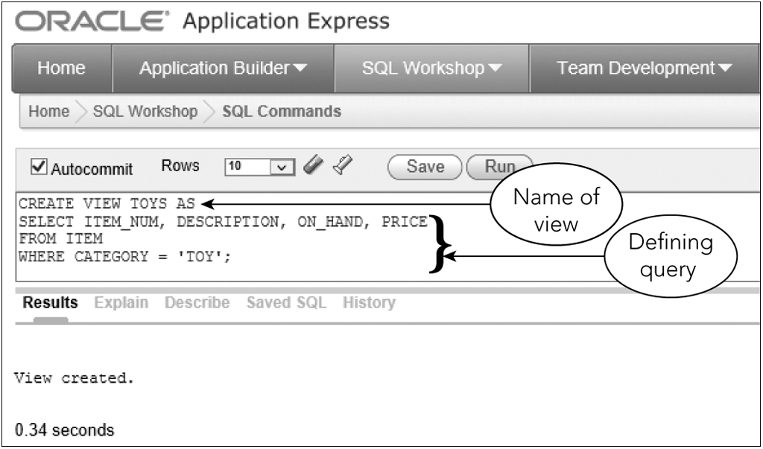
Creating and Using Views
Figure 7-1: Creating the TOYS view

Slide 7
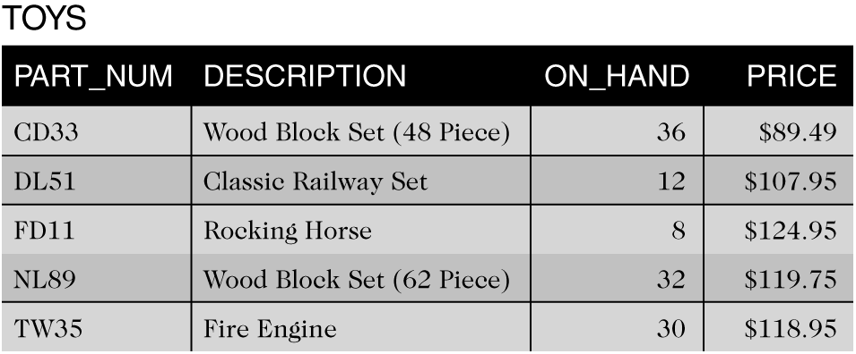
Creating and Using Views
Figure 7-2: TOYS view

Slide 8
Creating and Using Views
Data shown in Figure 7-2 does not exist in this form
Not a temporary table
To query a view, merge query that created view with query to select specific data

Slide 9
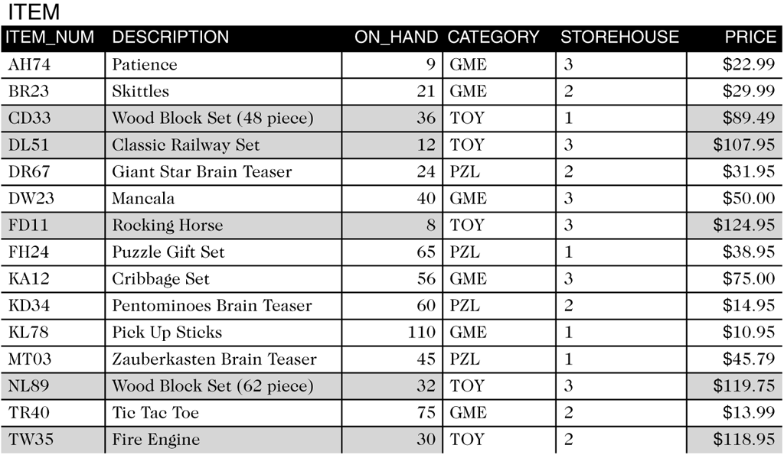
Creating and Using Views
Figure 7-3: User’s view of the ITEM table

Slide 10
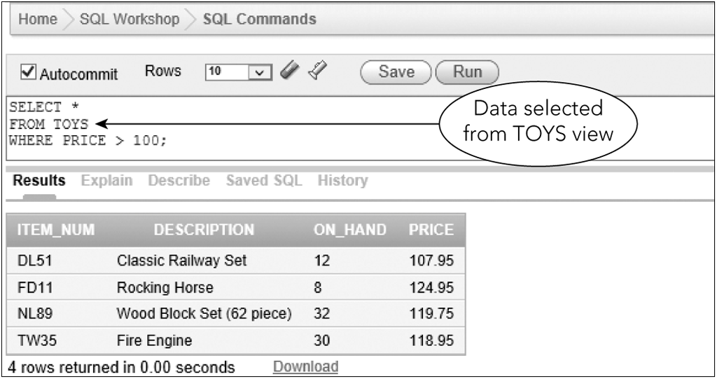
Creating and Using Views
Figure 7-4: Using the TOYS view

Slide 11
Creating and Using Views
Actual query executed by SQL
SELECT ITEM_NUM, DESCRIPTION, ON_HAND, PRICE
FROM ITEM
WHERE CATEGORY =‘TOY’
AND PRICE > 100;

Slide 12
Creating and Using Views
You can assign column names in view that are different than base table
Include new column names in parentheses, following the name of the view
Output will display new column names

Slide 13
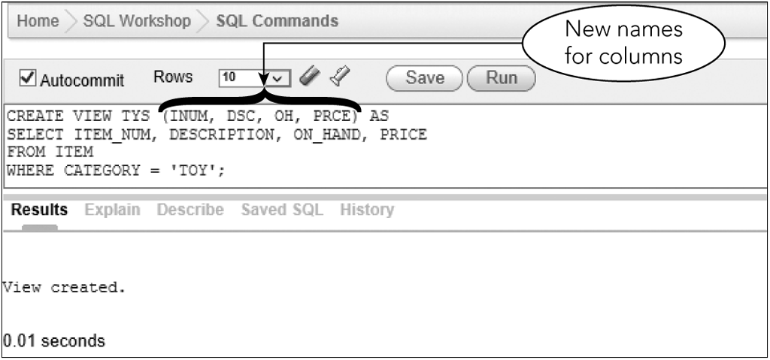
Creating and Using Views
Figure 7-5: Renaming columns when creating a view

Slide 14
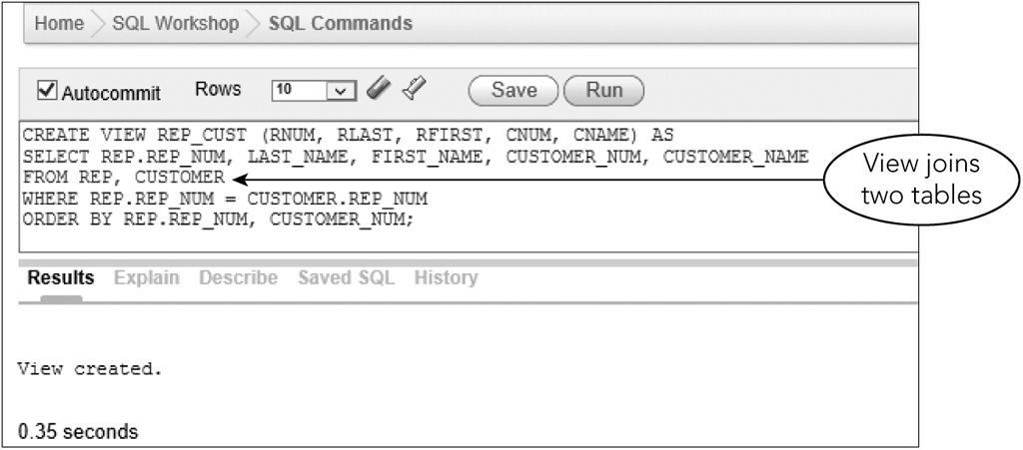
Creating and Using Views
Defining query of view can be any valid SQL query
View can join two or more tables
Figure 7-7: Creating the REP_CUST view

Slide 15
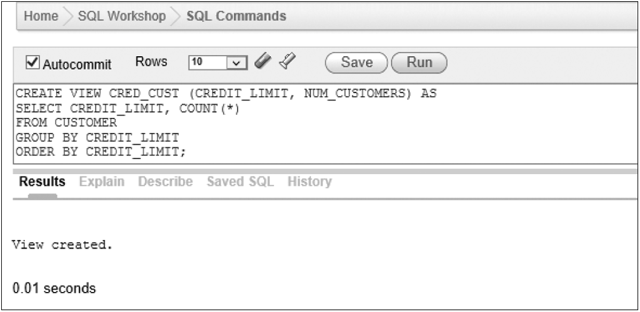
Creating and Using Views
A view can involve statistics
Figure 7-9: Creating the CRED_CUST view

Slide 16
Creating and Using Views
Benefits of views
Provide data independence
Can often be used even after database structure changes
Different users can view same data differently
Customize display to meet each user’s needs
A view can contain only those columns required by a given user
Simplifies user’s perception of database
Provides a measure of security

Slide 17
Using a View to Update Data
Benefits of views are for retrieval purposes only
Updating data through a view is dependent on type of view

Slide 18
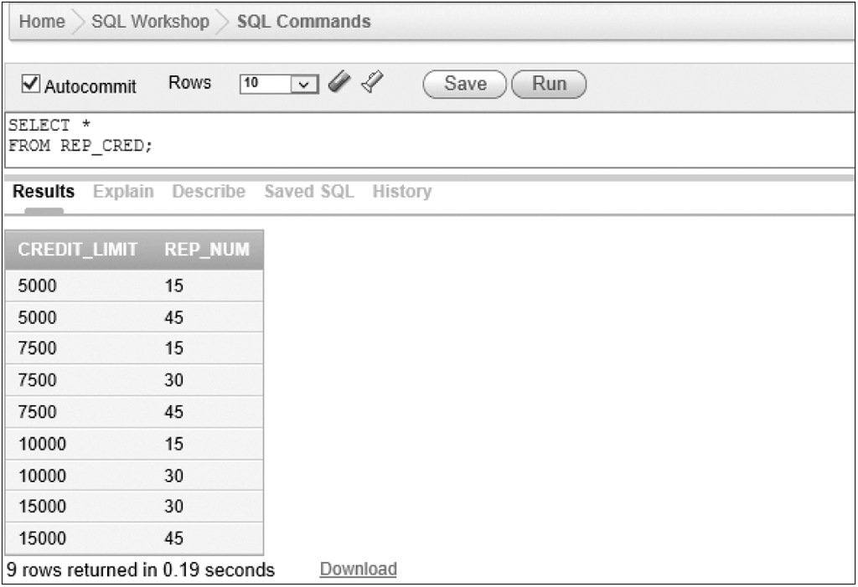
Updating Row-and-Column Subset Views
You can update (usually) if view contains primary key
You cannot update when primary key is not included
No primary key

Slide 19
Updating Views Involving Joins
Can update when a view is derived by joining two tables on primary key of each table
Cannot update when view involves joining by matching the primary key of one table with a column that is not the primary key
Encounter more severe problems if neither of the join columns is a primary key

Slide 20
Updating Views Involving Statistics
Most difficult to update
Cannot add rows to a view that includes calculations

Slide 21
Dropping a View
Remove a view that is no longer needed with DROP VIEW command
The DROP VIEW command removes only the view definition
Base table and data remain unchanged

Slide 22
Exercise
Use SQL to make the following changes to the TAL Distributors database. After each change, execute an appropriate query to show that the change was made correctly.
Create a view named MAJOR_CUSTOMER. It consists of the customer number, name, balance, credit limit and rep number for every customer whose credit limit is $10,000 or less.
Create a view named ITEM_ORDER. It consists of the item number, description, price, order number, order date, number ordered and quoted price for all order lines currently on file.
Create a view named ORDER_TOTAL. It consists of the order number and order total for each order currently on file. The order total is the sum of the number of units ordered multiplied by the quoted price on each order line for each order. Sort the rows by order number. Use TOTAL_AMOUNT as the name for the order total.

Slide 23
Security
Prevention of unauthorized access to a database
Some users may be able to retrieve and update anything in database
Other users may be able to retrieve data but not change data
Other users may be able to access only a portion of data

Slide 24
Security
GRANT command
Main mechanism for providing access to database
Database administrator can grant different types of privileges to users and revoke them later
Privileges include rights to select, insert, update, index, and delete table data

Slide 25
Security
Database administrator uses REVOKE command to remove privileges from users
Format is similar to GRANT command

Slide 26
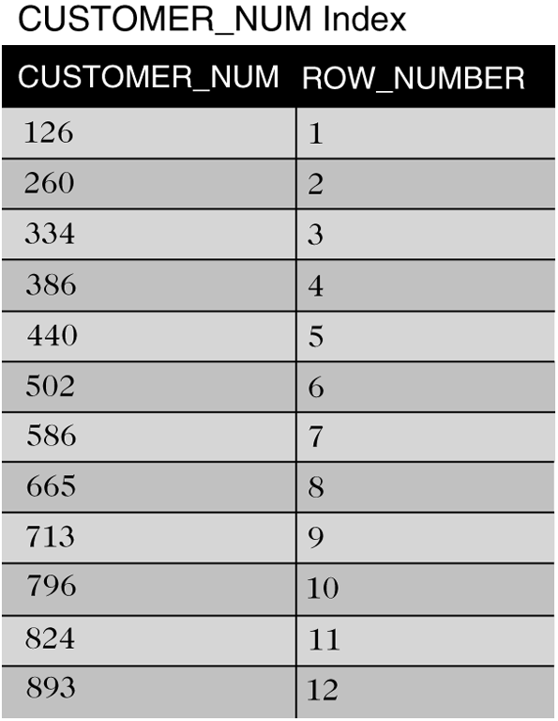
Indexes
Speeds up the searching of tables
Similar to an index in a book
Figure 7-19: Index for the CUSTOMER table on the CUSTOMER_NUM column

Slide 27
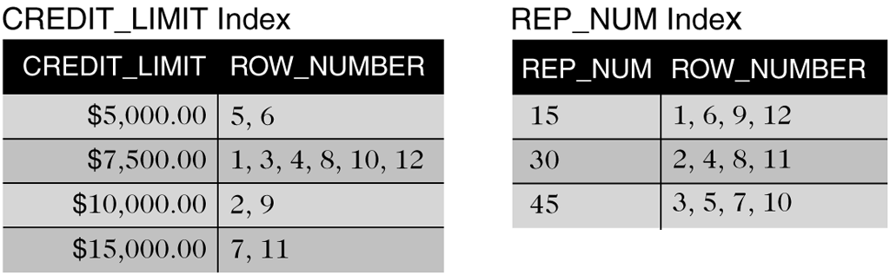
Indexes
Figure 7-20: Indexes for the CUSTOMER table on the CREDIT_LIMIT and REP_NUM columns

Slide 28
Indexes
SQL manages indexes
User determines columns on which to build indexes
Disadvantages
Index occupies disk space
DBMS must update index as data is entered

Slide 29
Creating an Index
Use CREATE INDEX command
Name the index
Identify the table
Identify the column or columns

Slide 30
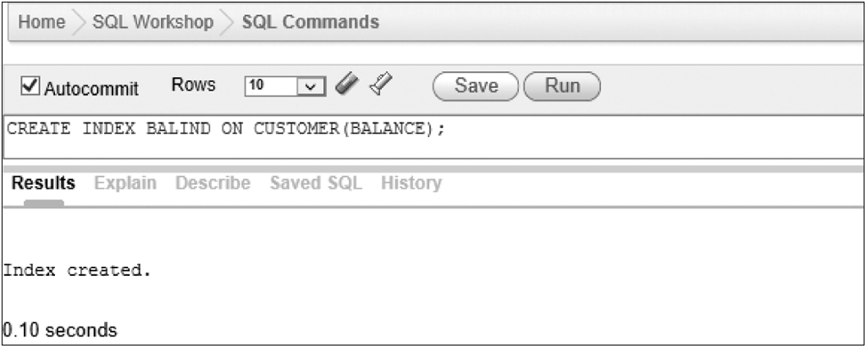
Creating an Index
Index on a single column
Figure 7-21: Creating the BALIND index on the BALANCE column

Slide 31
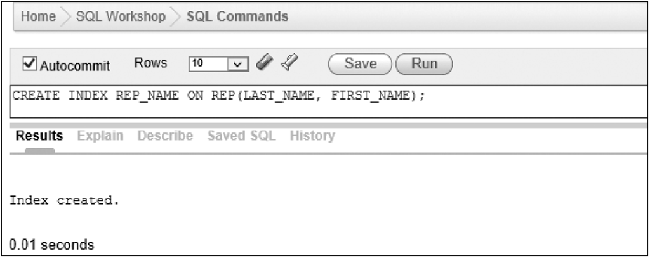
Creating an Index
Index on two columns
Figure 7-22: Creating the REP_NAME index on the LAST_NAME and FIRST_NAME columns

Slide 32
Dropping an Index
Use DROP INDEX to delete an index
DROP INDEX followed by name of index to drop
Permanently deletes index

Slide 33
Creating Unique Indexes
To ensure uniqueness of non-primary key data, you can create a unique index
Use CREATE UNIQUE INDEX command
A unique index will reject any update that would cause a duplicate value in the specified column

Slide 34
Exercise
Use SQL to make the following changes to the TAL Distributors database.
Create an index named ITEM_INDEX1 on the ITEM_NUM column in the ORDER_LINE tale.
Create an index named ITEM_INDEX2 on the CATEGORY column in the ITEM table.
Create an index named ITEM_INDEX3 on the CATEGORY and STOREHOUSE columns in the ITEM table.
Delete the index named ITEM_INDEX3.

Slide 35
System Catalog
Contains information about tables in database; also called data dictionary
Use SYSTABLES to list all tables in database
Use SYSCOLUMNS to list all columns in a table
Use SYSVIEWS to list information about views

Slide 36
System Catalog
In Oracle, use:
DBA_TABLES to list information about tables
DBA_TAB_COLUMNS to list information about columns
DBA_VIEWS to list information about views

Slide 37
Update of the System Catalog
DBMS updates automatically when
Create, alter, drop tables
Create or drop indexes
Users should not update catalog directly

Slide 38
Integrity Constraints in SQL
Rule for the data in the database
Examples in TAL Distributors
A sales rep’s number must be unique
The sales rep number for a customer must match an exiting sales rep number
Categories for items must be GME, TOY, or PZL

Slide 39
Integrity Constraints in SQL
Integrity support is process of specifying integrity constraints for the database
Clauses to support integrity constraints can be specified within a CREATE TABLE or ALTER TABLE command
ADD PRIMARY KEY
ADD FOREIGN KEY

Slide 40
Integrity Constraints in SQL
Primary keys
Use ADD PRIMARY KEY clause on ALTER TABLE command to add after creating a table
Foreign keys
A column in one table whose value matches the primary key in another
Legal values
The CHECK clause ensures only legal values are allowed in a given column

Slide 41
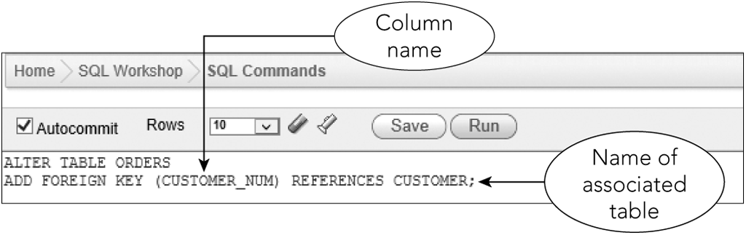
Integrity Constraints in SQL
Figure 7-24: Adding a foreign key to an existing table

Slide 42
Integrity Constraints in SQL
After creating a foreign key, DBMS rejects any update that violates the foreign key constraint
Error messages refer to parent and child
When specifying a foreign key, table containing foreign key is the child
Table referenced by foreign key is parent

Slide 43
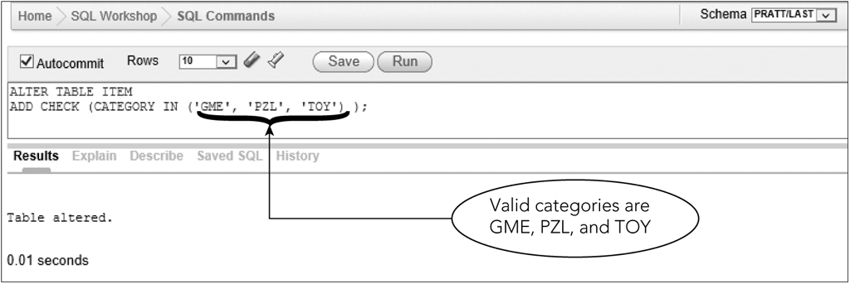
Integrity Constraints in SQL
Figure 7-27: Adding an integrity constraint to an existing table

Slide 44
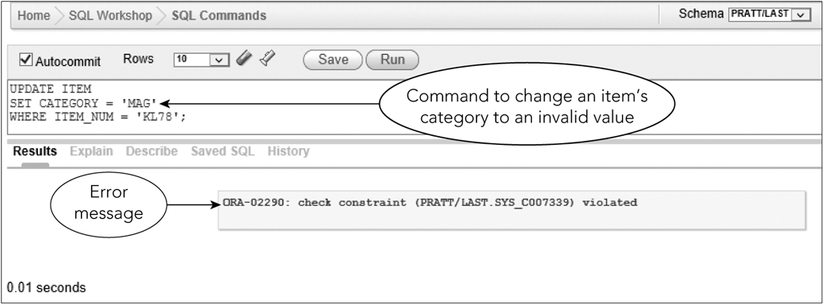
Integrity Constraints in SQL
Figure 7-28: Update that violates the integrity constraint

Slide 45
Summary
Views
CREATE VIEW command
Benefits
Update issues
DROP VIEW command
Security features
GRANT
REVOKE
Indexes
Make data retrieval more efficient
CREATE INDEX
DROP INDEX
System catalog information
SYSTABLES, SYSCOLUMNS, SYSVIEWS
DBA_TABLES, DBA_TAB_COLUMNS, DBA_VIEWS
Integrity constraints
ADD PRIMARY KEY
ADD FOREIGN KEY
CHECK

Slide 46
Exercise
Use SQL to make the following changes to the TAL Distributors database.
Add the ORDER_NUM column as a foreign key in the ORDER_LINE table.
Ensure that the only allowed values for the CREDIT_LIMIT are 5000, 7500, 10000 and 15000.
Toys Galore currently has a credit limit of $7,500. Since Toys Galore has an excellent credit rating, TAL Distributors is increasing the company’s credit limit to $10,000. If you run the SQL query from the exercise 1 on slide 22 after the credit limit has been increased, would Toys Galore still be included in the view? Why?
Run the query to increase the credit limit;
Run the query to select all rows from the MAJOR_CUSTOMER view.

